Slide 1
Operator Overloading

Slide 2
Introduction
Mechanism of giving special meaning to an operator is known as operator overloading.
Gives option to give new definitions to operators.
Syntax can’t be changed; but semantics can be.

Slide 3
Excluded operators
Class member access operators: ( . , .* )
Scope resolution operator ( :: )
Size operator ( sizeof )
Conditional operator ( ?: )

Slide 4

Defining operator overloading
To define additional task to operator, define its meaning.
Special function called operator function is used.
General form of operator function is:

Slide 5
Operator functions
Operator functions must be either member or friend functions.
 | Friend Function | Member Function
Unary Operator | 1 | 0
Binary Operator | 2 | 1

Slide 6
Operator invocation
Overloaded operator functions can be invoked (for unary operator) as:
op x or x op
Can be interpreted as:
operator op (x)
Example: - S or S -
Object

Slide 7
Operator invocation
Overloaded operator functions can be invoked (for binary operator) as:
x op y
Can be interpreted as:
x . operator op (y) → for member function
operator op (x , y) → for friend function

Slide 8
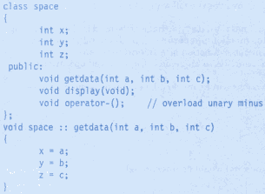

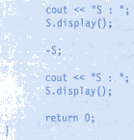

Overloading Unary operators

Slide 9
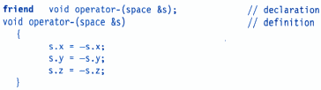
Overloading Unary operators
Using Friend function, it works as:

Slide 10
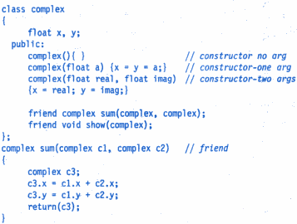
Overloading Binary operators
Consider following example to add 2 complex numbers using friend function as:

Slide 11
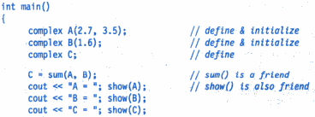


Slide 12
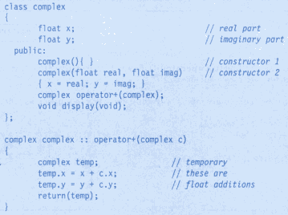
Overloading + operator

Slide 13
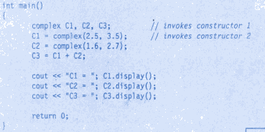
+ operator overloaded

Slide 14
The invocation: C3 = C1 + C2 is equivalent to:
Data members of C1 are accessed directly & that of C2 are accessed using dot operator

Slide 15
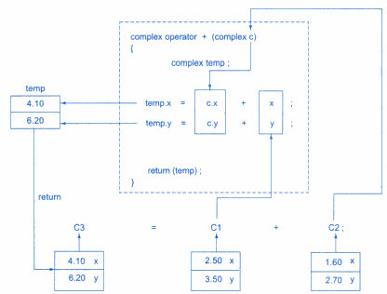

Slide 16
Overloading Binary operators using Friends
Friend functions can be used instead of member functions for overloading binary operator.
It requires 2 arguments to be passed explicitly; whereas member function requires only one.

Slide 17

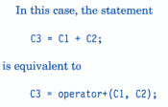
Previous example can be modified as:
Complex operator + (complex a, complex b)
{
complex temp;
temp.x = a.x + b.x;
temp.y = a.y + b.y;
return (temp);
}

Slide 18
Difference between Friend & Member function
Consider situation where 2 different data types are added as:
A = B + 2;
works for member function, but statement:
A = 2 + B;
will not work.
1st argument used to invoke function

Slide 19
Difference between Friend & Member function
However, friend function allows both approaches as:
X op Y
is interpreted as: operator op (X , Y)
And for member function, it can be interpreted as:
X . operator op (Y)

Slide 20
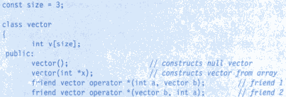
Example
Declaration of Operator function

Slide 21
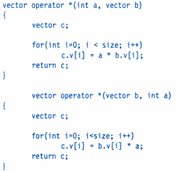
Example (cont.)
Definition of operator * functions

Slide 22
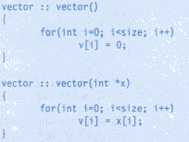


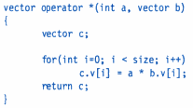
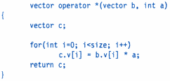
Example (cont.)

Slide 23

Point to be noted

Slide 24

Type Conversion
The statements:
converts x to integer before assigning to m.
Type conversions are automatic for built-in data-types.

Slide 25
Consider following statement:
v3 = v1 + v2 //v1, v2, v3 are objects
When objects are of same class, compiler doesn’t complain.
Compiler doesn’t support type conversion for user-defined data-types.
Therefore, conversion routines have to be developed.

Slide 26

Hence, 3 situations arrive:

Slide 27
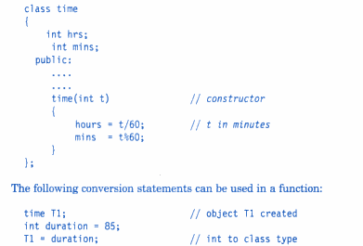
Basic → Class type
Built-in variable (duration) assigned to member variables
Constructor does the job

Slide 28
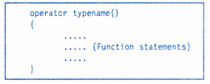
Class → Basic type
C++ allows us to define overloaded casting operator to convert class-type to basic-type.
It converts class-type data to typename.
Example: int num = obj; //object to int

Slide 29
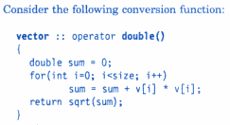

Example
Returning “double” value

Slide 30
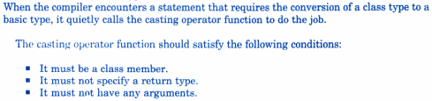

Slide 31

One Class → other Class type
Destination Class object
Source Class object
Conversion can be carried out using:
  Constructor function
  (or)
  Conversion function

Slide 32
(a) Conversion function
(used in source class)
Recall that, Casting operator function:
operator typename()
converts:
class object → typename()
typename() can be built-in or user-defined type.

Slide 33
(b) Constructor function
(used in destination class)
Here, argument belongs to source class and passed to destination class for conversion.
Hence, conversion constructor is placed in destination class.

Slide 34

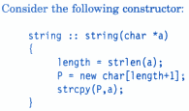
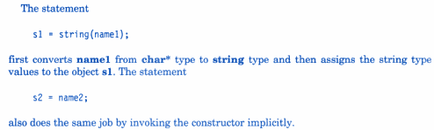
Example

Slide 35

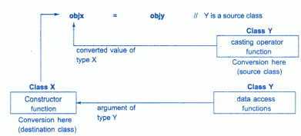
Conversion between objects

Slide 36
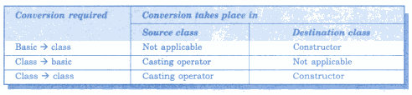
Conversion summary

